Slide 1
Decisioning in the cloud Internal audience
April 2020
Version 2.0 – updated taxonomy

Slide 2
About this document
This is an internal document to be used by key stakeholders of our integrated decisioning platform and related software-as-a-service propositions.
This document is NOT an external market-facing presentation and should not be shared outside the audiences indicated above or used for any external sales or marketing purposes.

Slide 3
A shift to the cloud

Slide 4
When it comes to moving to the cloud, many clients are no longer in a state of uncertainty… they now consider the cloud an imperative
Clients on moving to the cloud…
“We have a mandate to move everything onto the cloud. …we are on multiple clouds, multiple environments.”
“Initially, we were going with a “hard installation” with service, but cloud became absolutely imperative.”
“We are in the same place as everybody else about moving towards the cloud...Do we really want to build something in-house?”
Source: Experian buyer persona research (2019).

Slide 5
For clients, the business case for cloud is sound - they expect to accelerate innovation, improve agility, and simplify their IT environment
Clients top reasons for considering cloud technology
87%
Take advantage of innovation and new releases
85%
Improve business agility
85%
Eliminate the need to support infrastructure
84%
Remove IT complexity
Source: Experian market research (2016). Percentage choosing this reason in their top 3 for considering SaaS.

Slide 6



Clients expect to realise improvements when moving to the cloud but they remain concerned about security, scalability, and performance
Security
“We have regulatory issues. You can’t just take banking to the cloud... Are we going to be as secure as we were before?”
Client concerns
Scalability
“Can the software take 300% of volume load in case we need [it]?”
Performance
“…the system started degrading …[staff was] unable to do what they were required to do based on the response times...”
Source: Experian buyer persona research (2019).

Slide 7


Ensuring that cloud solutions are available, will integrate with existing systems, and can be easily updated are also top of mind with clients
Resilience
“…availability, resilience, all of the elements we have to follow from a regulatory point of view. ...very high 99% availabilities.”
Client concerns
Integration
“Integrating a new solution back into that system is always the challenge… integrate with the systems that we currently have?”
Upgrades
“…very old vendor packages… The cost and complexity to upgrade them is equal to or more than just going greenfield.”
Source: Experian buyer persona research (2019).

Slide 8
Introducing our cloud deployment platform

Slide 9











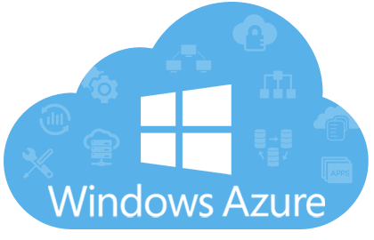

Our flexible, enterprise-grade cloud deployment platform supports a range of cloud-based solutions
Cloud-based solutions
A range of cloud-based solutions
Preconfigured SaaS solutions
Highly-configured solutions
Cloud deployment platform (Experian® One)
Deploy, run, and manage a range of solutions
Portal
Platform
Client Environment
Security
Scalability
Resilience
Monitoring
Business Intelligence
Platform-as-a-Service (PaaS)
IT environment
Clouds
Private

Slide 10



The platform includes a set of shared capabilities to efficiently access, configure, and manage applications
Solution portfolio
Client environment
The platform supports a range of cloud solutions for clients of all sizes
Preconfigured and bespoke solutions address a variety of requirements
Provides a foundation to run and manage a collection of solutions
Supports multiple environments (e.g., production and test)
Cloud deployment platform
(Experian® One)
Portal
Configuration management
A single entry point to access applications deployed on the platform
Connect to services like configuration and business intelligence
Manage configuration across all solutions deployed on the platform
Test, validate, and promote configurations (e.g. test to production)
Zero-downtime upgrades
Upgrade cloud-based applications without shutting down the system
Virtually eliminates downtime with a modern approach to upgrades

Slide 11


Enterprise-grade, platform-specific services ensure our cloud-based solutions are secure and can scale to accommodate growth
Security controls
Scalability
Access to systems is controlled with token-based security
Databases and storage are encrypted while data is separated between systems and clients
Includes autoscaling to automatically allocate more capacity to applications
Manage a surge in transactions or an increased workload for an application
Cloud deployment platform
(Experian® One)
Resilience
Monitoring
Applications running on the platform are redundant and can fail over
Systems will continue to operate when a disruption occurs
Client level monitoring tracks system performance and SLAs
Service status and is available to clients and Experian’s internal systems
Business intelligence
Business intelligence capabilities are shared across the platform
All cloud-based applications can leverage reporting tools

Slide 12
Cloud-based solutions

Slide 13











To deploy our existing software in the cloud, we had to modernise the way it is developed so it can run on a cloud platform
Traditional software
Containerised application
Cloud-based application
Developed by Global DA
(e.g., PowerCurve)
Cloud deployment platform
(Experian One)
IT environment
Our traditional products combine different capabilities in a single, self-contained application
Kubernetes is a technology we use to manage containerised applications
Client Environment
Security
Scalability
Resilience
Capabilities from our traditional products have been rebuilt as small, standalone services
Capabilities (services) are put in “containers” and assembled to solve a client problem
Monitoring
Business Intelligence

Slide 14





We are using capabilities from PowerCurve Originations to develop the first set of cloud-based solutions on the Experian One platform
We started our cloud transition by re-engineering PowerCurve Originations so it could run in containers
Capabilities from PowerCurve Originations are “containerised” and combined to create unique, cloud-based applications
Containers are very flexible and can run on a variety of cloud platforms
PowerCurve®
Originations
PowerCurve Customer
Acquisition
PowerCurve Originations
Preconfigured SaaS solution
Highly-configured solution
Private

Slide 15

Our decisioning vision includes a portfolio of cloud-based solutions that are based on our existing technology
Cloud decisioning solution portfolio
Preconfigured SaaS solutions
Standardised offerings
Configuration options
Rapid deployment
Bespoke, highly-configured solutions
Single client solutions
Tailored to client needs
Client control
PowerCurve® Customer Acquisition
PowerCurve® Originations
PowerCurve® Eligibility Check
PowerCurve® Customer Management
PowerCurve® Collections
PowerCurve® Collections
Strategy Design Studio
 | Available in select regions |  | Shared capability |  | Roadmap

Slide 16
Our cloud deployment platform and cloud-based solutions fit together to address a wide variety of clients with a range of needs
3
Solutions are based on PowerCurve but can also be independent
Preconfigured and bespoke solutions are supported
Appropriate for a range of clients - small to very large
Clients can access one or multiple products deployed on the platform
Common services are shared across environments (e.g. bureau connections, etc.)
Solutions are standalone but configuration is managed across environments
INSTANT BANK
UPTOWN BANK
UNIVERSAL BANK
2
2
6
PowerCurve Customer Acquisition
PowerCurve Originations
PowerCurve Originations
4
CrossCore
Production
Test
Production
Test
Production
Test
Production
Test
1
Preconfigured PCO
Preconfigured PCO
PCO
(Bespoke)
PCO
(Bespoke)
PCO
(Bespoke)
PCO
(Bespoke)
CC-PCO
CC-PCO
PCSM
PCSM
PCSM
PCSM
PCSM
PCSM
PCSM
PCSM
5
Client services
Client services
Client services
Cloud deployment platform (Experian One)
The platform where we execute products from Decision Analytics. It supports clients and multiple solutions
Includes a common set of capabilities for security, user management, configuration, reporting, etc.
IT environment
IT infrastructure that our cloud platform runs on and in

Slide 17




Preconfigured SaaS solutions are designed for clients that prefer an out-of-the-box offering that doesn’t require any customisation
For clients that…
Prefer that a 3rd party manages software infrastructure
Favor a standardised offering and avoid customisation
Require systems that offer a rapid implementation
May be a smaller organisation (e.g., Tier 2/3) but larger firms (or divisions of) may have similar needs
Preconfigured SaaS solutions
Employ a fully integrated solution with data, analytics, decisioning, and workflow
Adjust settings and configure parameters to meet unique business needs.
Realise a rapid deployment.
Flexibly manage IT investments with transaction-based pricing.
Drive innovation with access to regular, frequent updates.
Application Portfolio
PowerCurve Customer Acquisition
PowerCurve Eligibility Check
Roadmap
PowerCurve Collections

Slide 18

For clients with sophisticated requirements, our cloud platform supports highly-configured solutions that offer a significant level of control
For clients that…
Have significant IT, Risk, and Data Science resources
Want the ability to control strategy design and management and fully customise screens, workflows, etc.
Wish to use a wide range of data sources and sophisticated analytics (e.g., models developed w/ML).
Require flexible deployment options (e.g. public/private cloud).
Highly-configured solutions
Fully customise and tailor solutions to meet unique business needs.
Gain control over strategy and process design.
Leverage enterprise-grade capabilities to ensure performance, reliability, and security.
Ease system upgrades with updates that are pushed out automatically.
Create a migration path for existing PowerCurve solutions.
Application Portfolio
PowerCurve Originations
Roadmap
PowerCurve Customer Management
PowerCurve Collections

Slide 19
Delivering value through the cloud

Slide 20



A cloud-based delivery model and the services shared across Experian One allow us to deliver more value to clients
Commercial Leader
Commercial Leader
Risk Leader
IT Leader
Get to market quickly with solutions that are deployed rapidly and offer low up front costs
Stay ahead of the market with frequent enhancements and updates that are applied automatically
Start small and scale rapidly as volumes increase or as business requirements evolve
Measure performance with insightful reports and dashboards that are shared across Experian One solutions
Evaluate new strategies in a test environment and easily move a configuration from test to production
Integrate with data sources and other systems to access new information for a more thorough risk evaluation
Simplify the IT environment with cloud-services that eliminate the need to manage hardware, other infrastructure
Minimise lengthy and costly delivery projects with solutions that can be deployed in weeks
Keep systems up to date and secure with frequent, regular updates that are applied automatically

Slide 21
For Experian, a cloud model allows us to be more agile and efficient and resolve many of the challenges in our on-premise business
Current on premise challenges…
Our cloud-first future…
Hundreds of different software versions in the market
System maintenance is costly and complex
Upgrades are inconsistent and intermittent
Complying with security standards is challenging
Fixes to one system are difficult to apply across all
Single version across the estate
System maintenance is automated
Systems updates are frequent and simultaneous
Fixes are automatically applied to all systems
Everything is automated and standardised
VS

Slide 23
For many of our clients, a cloud-based software deployment is no longer an option… it is mandatory
Cloud computing is top of mind for clients
Top reasons clients are moving to the Cloud
A strong majority of clients consider Cloud options
“We have a mandate to move everything onto the cloud. …we are on multiple clouds, multiple environments.”
“Initially, we were going with a “hard installation” with service, but cloud became absolutely imperative.”
“We are in the same place as everybody else about moving towards the cloud... Do we really want to build something in-house?”
Take advantage of innovation/new releases | 87%
Improve business agility | 85%
Eliminate need to support infrastructure | 85%
Remove IT complexity | 84%
86%
of clients currently buy or would consider SaaS for Decisioning
Source: Experian buyer persona research (2019)
Source: Experian market research (2016). Percentage choosing this reason in their top 3 for considering SaaS.
Source: Experian market research (2016)

Slide 24

The cloud applications that run on Experian One are based on the existing software solutions developed by Experian Decision Analytics
TRADITIONAL SOFTWARE
SERVICES
CLOUD-BASED APPLICATIONS
Data connectivity
Decisioning
Preconfigured
Bespoke
Purpose-built
Workflow
Experian One platform
Current products (e.g. PowerCurve) combine different capabilities into a single, self-contained application
Examples of core capabilities:
Screens (UI)
Data connectivity
Data enrichment
Decisioning
Workflow
Capabilities from our traditional software products have been rebuilt as smaller standalone services
Services (or micro capabilities) are “containerised”
Suitable for cloud deployment
Cloud-based applications are created using a collection of services and deployed on Experian One
Capabilities (services) are assembled to address a range of use cases
Kubernetes is used to deploy, manage, and scale containers

Slide 25
Our vision for Experian One includes a portfolio of cloud-based applications that are based on our existing technology
Experian One solution portfolio
Preconfigured applications
Standardised offerings
Highly configurable
Rapid deployment
Bespoke cloud applications
Tailored to client needs
Client control
Continuous innovation
Purpose-built applications
Data access
Strategy management
Orchestration engine
PowerCurve® Customer Acquisition
PowerCurve® Originations
CrossCore™
PowerCurve® Eligibility Check
PowerCurve® Customer Management
PowerCurve® Collections
PowerCurve® Collections
 | Available in select regions or for select clients
 | Capability available across solutions
 | On roadmap
Strategy Design Studio

Slide 26
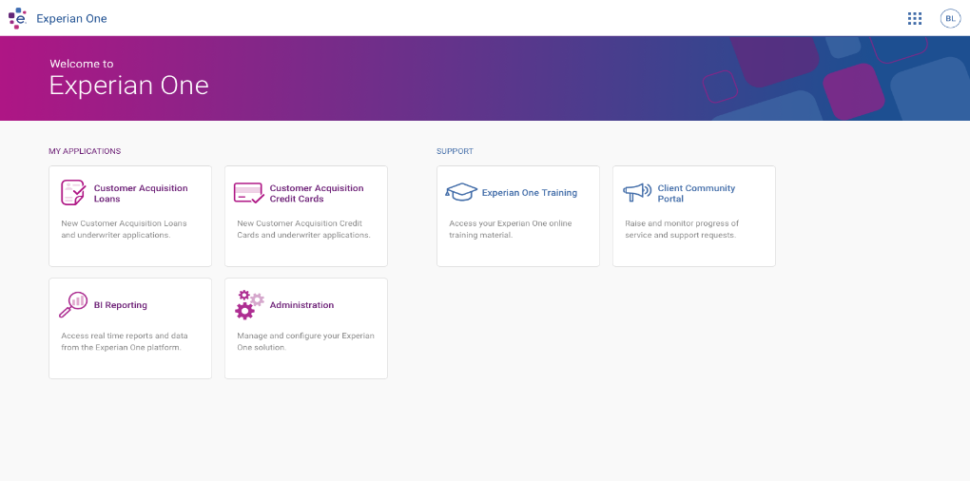
Experian One includes a portal to configure and launch applications or access shared capabilities like reporting and learning management
The Experian One portal allows user to easily navigate between applications
Administrators can manage users and configure applications
Real-time reports and data are accessible through the portal
Online training and other support features are readily available
A customer (common login, portal and other services)
Use case 1:
Use case 2:
Prod
Test
Other
Prod
Perf
UAT
Product
1
Product
1
Product
1
Product
2
Product
2
Product
2
Client services

Slide 27
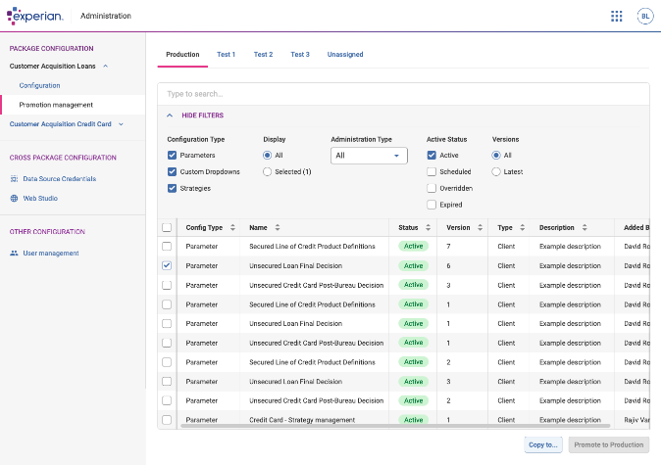
With Experian One, we made it easy to move a configuration across different client environments (e.g., test to production)
A customer (common login, portal and other services)
Most traditional enterprise software solutions do not provide tooling to move configuration between environments
For a long time, companies were happy with this, as they built manual processes to control configuration.
In Experian One, we provide tools, versioning and UI across all configuration.
This works independently of the product software. This is for example how we can manage strategy deployment to different environments and solutions.
Use case 1:
Use case 2:
Prod
Test
Other
Prod
Perf
UAT
Product
1
Product
1
Product
1
Product
2
Product
2
Product
2
Client services
Config

Slide 28

Experian One supports use cases outside of our traditional decisioning business with purpose-built applications
For clients that…
May struggle with a complex IT environment (variety of platforms, systems) they wish to modernise and simplify.
Lack IT capacity and prefer a 3rd party manage infrastructure.
Require flexible deployment options and a choice of clouds.
Value a rapid, straightforward deployment process.
Purpose-built Applications
Access solutions designed for specific business processes or use cases.
Leverage enterprise-grade capabilities to ensure performance, reliability, and security.
Ease system upgrades with updates that are pushed out automatically.
Combine with other Experian One solutions in a single client environment.
Application Portfolio
CrossCore
Roadmap
Attribute Toolbox

Slide 29

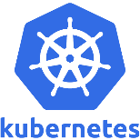



Leading cloud technologies underpin the Experian One cloud platform
 | A private PaaS (Platform-as-a-Service) solution to build, deploy and run container-based applications
 | Platform for automating deployment, scaling, and operations of application containers across clusters of hosts.
 | Tool to package an application and its dependencies in a virtual container that can run on any Linux server (deployed on premises or in the cloud).
 | API management to expose services to the outside world with a gateway for security enforcement (e.g. authentication, authorisation, etc.)
 | Data analytics and visualisation tools for developing reports and dashboards.
Platform Services
API Gateway
Operational Reporting

Slide 30





Sophisticated API management tools facilitate connecting to our SaaS applications and data
API MANAGEMENT
We are using the Apigee platform to develop and manage the APIs we expose to clients.
Apigee securely protects our services and monitors the services to ensure scalability.
Clients are required to register to use our APIs and Apigee will manage the authentication process each time they are accessed.
This configuration allows us to change our SaaS services without impacting public APIs.
SaaS
Service
API
Proxy 1
API
Product A
REST
SaaS
Service
API
Proxy 2
API
Product B
REST
SaaS
Service
API
Proxy 3
API
Product C
REST
SaaS
Service
API
Proxy 4
REST
MANAGEMENT UI
Analytics & Monitoring
Developer Services
API
Services

Slide 31



Sophisticated API management tools facilitate connecting to our SaaS applications and data
API MANAGEMENT
We are using the Apigee platform to develop and manage the APIs we expose to clients.
Apigee securely protects our services and monitors the services to ensure scalability.
Clients are required to register to use our APIs and Apigee will manage the authentication process each time they are accessed.
This configuration allows us to change our SaaS services without impacting public APIs.
SaaS
Service
API
Product A
API
Proxy 1
REST
SaaS
Service
API
Proxy 2
REST
API
Product B
SaaS
Service
API
Proxy 3
REST
API
Product C
SaaS
Service
API
Proxy 4
REST
MANAGEMENT UI
Analytics & Monitoring
Developer Services
API
Services

Slide 32
We are using capabilities from PowerCurve to develop the cloud-based solutions that run on the Experian One platform
PowerCurve® Originations was first but we can put any application in containers
The platform is agnostic to the type of application
To “containerise”, capabilities from our traditional software products have been rebuilt as smaller standalone services
These individual services or “micro capabilities” can be used in isolation or combined with other capabilities to solve new challenges
We started our cloud transition by putting PowerCurve® Originations inside containers
PowerCurve®
Originations

